Slide 1


Slide 2
Introductions
July 2024

Slide 3
Introductions
Project Requirements
Workspace Preparation

Slide 4

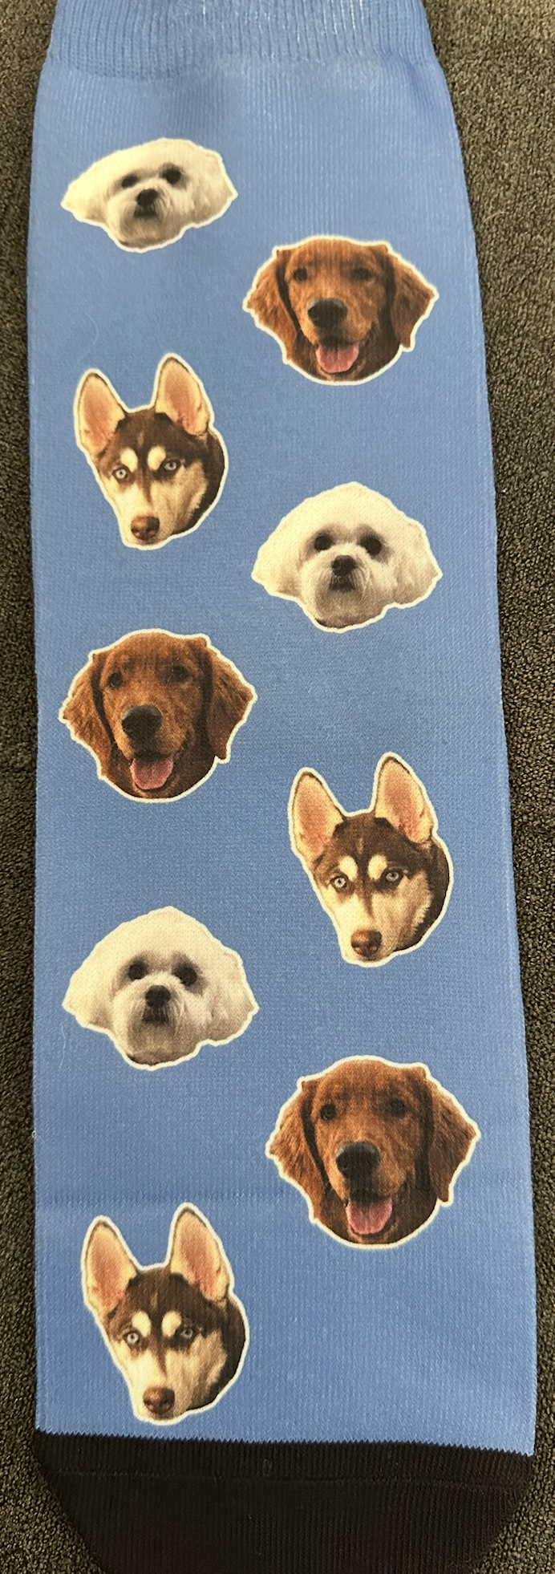


Introductions
Born in New Delhi, India
Grew up in Folsom, CA and Okemos, MI
BS Computer Science at Umich
MS Software Management at CMU
Software Engineer Ascend. Prev at Lob
Live in SF
Enjoy going to the gym, hanging out in the park and the beach, road trips, TV/movies, sports

Slide 5
Weekly Agenda

Slide 6
Weekly Agenda
Week 1: Introductions
Week 2: Project Ideation
Week 3: Database Design and Setup
Week 4: Backend Development
Week 5: API Development
Week 6: JavaScript Frameworks and Frontend Development
Week 7: Frontend Development and Putting it All Together
Week 8: Presentations

Slide 7
Multi-Tier Architecture

Slide 8
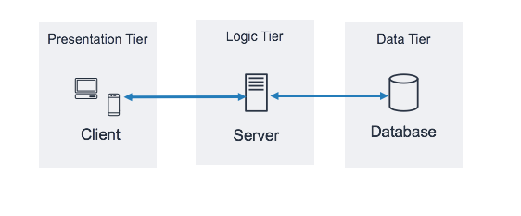
Multi-Tier Architecture

Slide 9

Presentation Tier
Definition: The topmost layer, responsible for displaying information to the user and handling user interactions.
Examples: Web browsers, mobile apps, desktop GUIs
Responsibilities:
User interface and experience
Data input and validation
Sending requests to the logic tier
Technologies: HTML, CSS, JavaScript, React, Angular

Slide 10
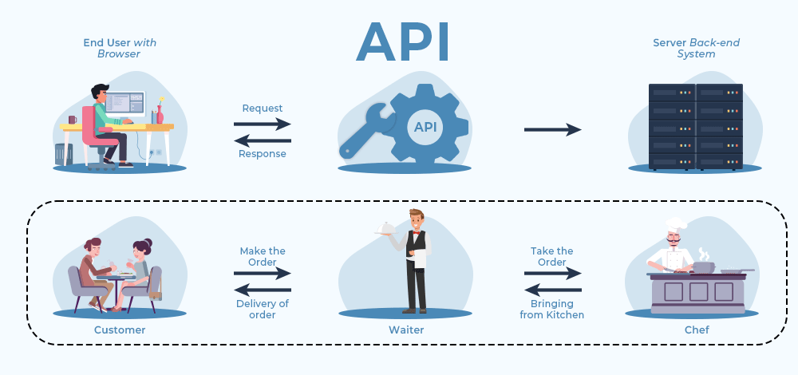
Logic Tier
Definition: The middle layer, responsible for processing user inputs, applying business rules, and making logical decisions.
Examples: APIs
Responsibilities:
Processing requests from the presentation tier
Implementing business logic and rules
Communicating with the data tier
Technologies: Java, C#, Node.js, Python

Slide 11

Data Tier
Definition: The bottom layer, responsible for storing and retrieving data from databases or other data storage systems.
Examples: SQL databases, NoSQL databases, file storage systems
Responsibilities:
Managing data storage and retrieval
Ensuring data integrity and security
Providing data to the logic tier
Technologies: MySQL, PostgreSQL, MongoDB

Slide 12

Benefits and Challenges
Benefits:
Scalability
Maintainability
Flexibility
Reusability
Challenges:
Complexity
Performance Overhead
Development Time

Slide 13
Project Requirements

Slide 14

General Requirements
Develop a full stack application utilizing a three-tier architecture
The application should include a creative and meaningful dataset

Slide 15
Frontend Requirements
User Interface
Design an intuitive and user-friendly interface
Include features like navigation menus, forms, and interactive elements.
Technologies
Use modern frontend technologies such as HTML, CSS, JS/TS
Utilize a frontend framework like React, Angular, or Vue.js
For this project we will be using Next.js

Slide 16
Backend Requirements
Application Logic
Implement core business logic and rules
Ensure secure handling of data and user interactions
Technologies
Develop RESTful APIs to handle requests from the frontend
For this project we will be using Next.js deployed on Vercel
Functionality
Process and respond to frontend requests
Interact with data tier

Slide 17
Data Tier
Database Design
Create a normalized database schema
Define relationships between entities
Technologies
Use a relational database like MySQL, Postgres
For this project we will be using a Postgres database and Prisma
Functionality
Implement CRUD operations

Slide 18
Workspace Preparation

Slide 19
Things to Download
Github (setup an account): https://docs.github.com/en/get-started
Think about the dataset you want to use
Node.js: https://nodejs.org/en/download
Postgres: (SQL Intro: https://www.w3schools.com/sql/)
Prisma: https://www.prisma.io/docs/orm
Next.js: https://nextjs.org/docs

